Slide 1
Improving some bounds for multiple domination parameters in graphs
Hamid Reza Golmohammadi
Department of Computer
Ale-Taha Institute Of Higher Education

Slide 2
Outline
Dominating Sets
New Results
Multiple Dominating Sets

Slide 3
Dominating Sets
Let G be a finite connected graph with vertex set V = V (G) and edge set E = E(G).
Each vertex of a graph is said to dominate every vertex in its closed neighborhood.
A set S ⊆ V is a dominating set in G if each vertex in V (G) is dominated by some vertex in S.
G
S
A
B
3
Notes:
3

Slide 4
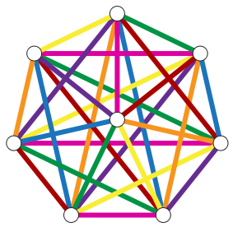
The minimum cardinality of a dominating set in G is the domination number denoted γ (G) . A minimum dominating set of a graph G is called γ (G) –set Consider the graph G .
v₁
v₇
v₂
v₈
v₆
v₃
v₅
v₄
It is esay to see that γ (G) =1 and the set {v₈ } is a γ (G) –set
4

Slide 5
Multiple dominating sets
Multiple dominating sets are as follows :
k- dominating set
k –tuple dominating set
k –tuple total dominating set
k –tuple restranied dominating set
k –tuple total restrained dominating set
5

Slide 6
k-dominating set
J.F. Fink , M.S. Jacobson (1985)
A subset S⊆ V is a k-dominating set of the graph G if every vertex v∈ V−S is adjacent to at least k vertices of S.
The k-domination number γ_{k} (G) is the minimum cardinality of a k- dominating set.
G
S
k=2
v₁
v₂
v₃
6

Slide 7
Lower bounds on k- domination number
Theorem 1 (Jacobson , et al-1985).
If G is a graph with n vertices and with m edges, then for
each k ≥1.
γ_{k} (G) ≥ n –(m/k)

Slide 8
k-tuple dominating set
F. Harary and T.W. Haynes (2000)
The k-tuple dominating set of a graph G is a
subset S ⊆ V with this property that every vertex in V- S has at
least k neighbors in S and every vertex in S has at least ( k -1) neighbors in S.
The k-tuple domination number , γ_{×k}(G) of a graph G is the minimum cardinality of a k-tuple dominating set.
G
S
k=2
8

Slide 9
Lower bounds on k-tuple domination number
Theorem 1 (Harary, et al-2000). Let G be a graph of order n and δ(G) ≥ k-1 then ,
γ_{×k}(G) ≥ (2kn -2m) /(k+1).

Slide 10
k-tuple total dominating set
M.A. Henning and A.P. Kazemi (2010)
The k-tuple total dominating set of a graph G is a
subset S ⊆ V with this property that every vertex in V has at
least k neighbors in S .
The k-tuple total domination number, γ_{×k,t}(G) of a graph G is the minimum cardinality of a k-tuple total dominating set.
G
S
k=2
10

Slide 11
Lower bound on k-tuple total domination number
Theorem 2 (A.P. Kazemi et al-2012) If G is a graph with minimum degree at least k on n vertices and with m edges, then
γ_{×k,t}(G) ≥ 2 (n- (m/k)) .
This bound is sharp.

Slide 12
k-tuple restrained dominating set
A.P. Kazemi (2014)
The k-tuple restrained dominating set of a graph G is a
subset S ⊆ V with this property that every vertex in V –S has at
least k neighbors in V-S and to at least k vertices in S and every vertex in S has at least k-1 neighbors in S.
The k-tuple restrained domination number, γ^{r}_{×k}(G), of a graph G is the minimum cardinality of a k-tuple restrained dominating set.
G
S
k=2
12

Slide 13
Lower bound on k-tuple restrained domination number
Theorem 8 ( Adel.P . Kazemi-2014 ) If G is a graph with minimum degree at least k-1 on n vertices and with m edges, then
γ^{r}_{×k}(G) ≥ (3kn-2m)/2k+1

Slide 14
k-tuple total restrained dominating set
A.P. Kazemi (2012)
The k-tuple total restrained dominating set of a graph G is a
subset S ⊆ V with this property that every vertex in V has at
least k neighbors in S and every vertex in V \S has at least k neighbors in V \S.
The k-tuple total restrained domination number, γ^{r}_{×k,t}(G), of a graph G is the minimum cardinality of a k-tuple total restrained dominating set.
G
S
k=2
14
Notes:
14

Slide 15
Lower bound on k-tuple total restrained domination number
Theorem 8 ( Adel.P . Kazemi-2012 ) If G is a graph with minimum degree at least k on n vertices and with m edges, then
γ^{r}_{×k,t}(G) ≥ )3n/2 ( − )m/k(.

Slide 16
(k, k′, k′′)-dominating set
H.R. Golmohammadi , Abdollah Khodkar , B.Samadi (2015 , accepted for publication in the journal of combinatorial mathematics and combinatorial computing)
Let k, k′ and k′′ be nonnegative integers. A set S ⊆ V is a
(k, k′, k′′)-dominating set in G if every vertex in S has at least k neighbors in S and every vertex in V \ S has at least k′ neighbors in S and
at least k′′ neighbors in V \ S.
A (4, 3, 5) dominating set
G
S
16
Notes:
16

Slide 17
The (k, k′, k′′)-domination number γ_{(k,k}′_{,k}′′₎ (G)
is the minimum cardinality of a (k, k′, k′′)-dominating set.
Every graph with δ ≥ k has a (k, k′, k′′)-dominating set.
If δ < k′+k′′, then V is a (k, k′, k′′)-dominating set.
17

Slide 18
Relation among (k,k’,k’’)-domination number and multiple domination parameters
γ_{(0,k,0)}(G) = γ_{k} (G)
γ_{(k-1 ,k,0)}(G) = γ_{×k} (G)
γ_{(k ,k,0)}(G) = γ_{×k,t} (G)
γ_{(k-1 ,k,k)}(G) = γ^{r}_{×k} (G)
γ_{(k ,k,k)}(G) = γ^{r}_{×k,t} (G(
18
Notes:
18

Slide 19
Lower bound on (k, k′, k′′)- domination number
H.R. Golmohammadi , A. Khodkar (2014)
Main Theorem: Let G be a graph with δ(G) ≥ k. Then
γ_{(k,k}′_{,k}′′₎ (G) ≥ ((k′ + δ∗)n − 2m)/(δ∗ + k′ − k),
Where
δ∗ = min{deg(v) | v ∈ V (G) and deg(v) ≥ k′+ k′′}.
19
Notes:
19

Slide 20
We now improve the lower bounds given in theorems (1),(2), . . .... ,(5) by the main theorem.
γ_{k}(G) = γ_{(0 ,k,0)}(G) ≥ (k+ δ*)n − 2m)/(δ*+k)
≥ n − (m/k )
γ_{×k,t}(G) = γ_{(k ,k,0)}(G) ≥ ((k+ δ*)n − 2m)/δ∗
≥ (2kn − 2m)/k
γ_{×k}(G) = γ_{(k -1 ,k,0)}(G) ≥ ((k+ δ∗)n − 2m)/(δ∗ +1)
≥ (2kn − 2m)/(k +1)
γ^{r}_{×k}(G) = γ_{(k-1,k,k)}(G) ≥ ((k+ δ∗)n − 2m)/(δ*+1)
≥ ) 3kn-2m(/(2k+1)
γ^{r}_{×k,t}(G) = γ_{(k,k,k)}(G) ≥ ((k+ δ∗)n − 2m)/δ∗
≥ 3n/2 − m/k.
20
Notes:
20

Slide 21

Professor Peter J. Slater - University of Alabama

Slide 22

Professor Michael Henning -University of Johannesburg

Slide 23

Professor Lutz volkmann - RWTH Aachen University

Slide 24

Iran - Shiraz
Eram Garden

Slide 25
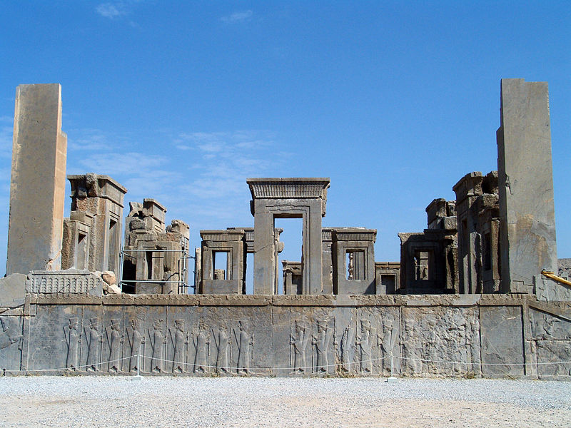
Iran - Shiraz
Persepolis

Slide 26

Iran - Shiraz
Tomb of Hafez

Slide 27

Iran - Esfahan
Si-o-se-pol

Slide 28

Iran - Tehran
Niavaran Complex

Slide 29


Slide 30


Slide 31
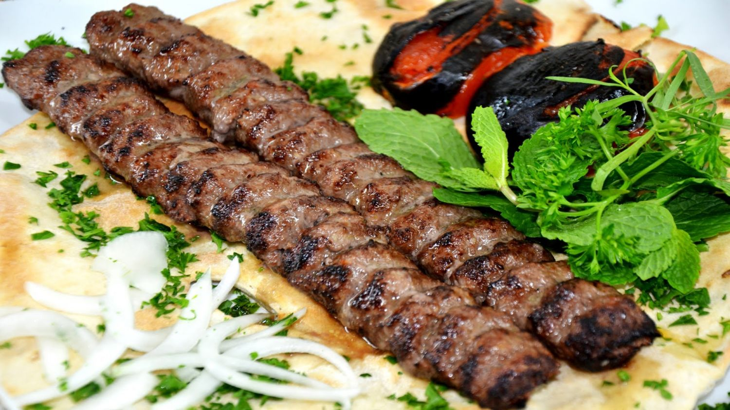

Slide 32
I WISH YOU ALL THE BEST
32
Notes:
32

